Slide 1
Supply Chain Management: Distribution and warehousing, Inventory Measures & Supplier Selection
BUSI 104
Professor Arnheiter

Slide 2
Warehousing
Consolidation warehousing
Cross-docking
Hub-and-spoke systems

Slide 3
Consolidation Warehousing
Small trucks arrive from different plants, suppliers, etc.
Large, economical shipments outbound
Small, flexible shipments inbound

Slide 4
Cross-Docking
Small, flexible shipments outbound
Large economical shipments inbound

Slide 5
Hub-and-Spoke Systems
Strategically placed “hubs” used as sorting or transfer facilities
Combines benefits of consolidation and cross-docking
Take advantage of economies of scale – hubs do no hold inventory
Located at convenient, high-traffic locations (airport, etc.)
“Spokes” refer to routes serving destinations associated with hubs

Slide 6
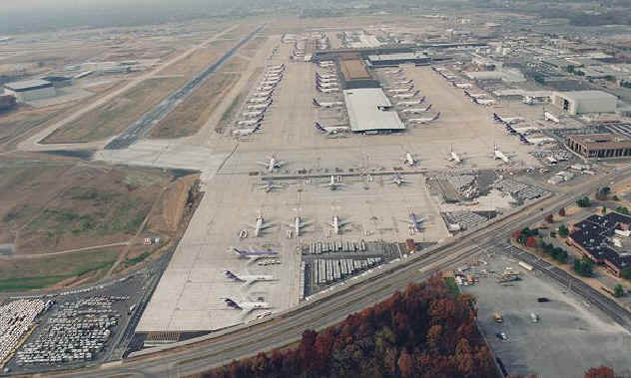
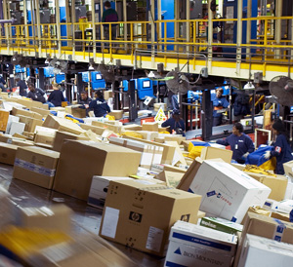
Hub-and-Spoke System - FedEx
FedEx Hub at Memphis International Airport: 2.4 million sq. ft. under roof with throughput of 1.5 million packages/day.

Slide 7
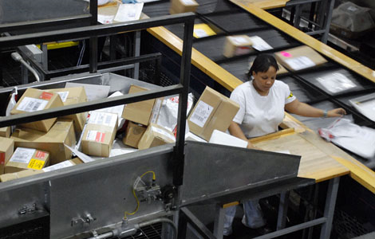
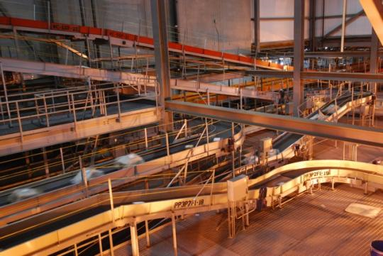
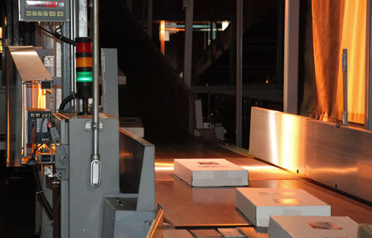
Hub-and-Spoke System: UPS Worldport Louisville, KY
UPS Worldport video – Discovery Nerve Center UPS Worldport
https://www.youtube.com/watch?v=rIDKgtaof4Y
Notes:
https://www.youtube.com/watch?v=rIDKgtaof4Y
Worldport video – Discovery Nerve Center UPS Worldport – 46 minutes
Notes are summarized in Word file.
NOVA: Stabilizing Vaccines with Silk. https://www.youtube.com/watch?v=hj4bmo8UWiQ. 3:57 length.

Slide 8
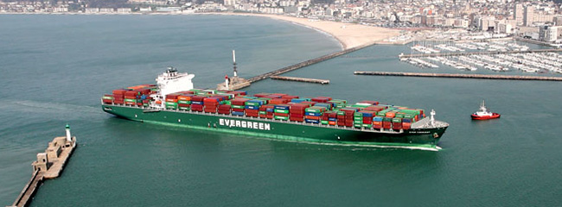
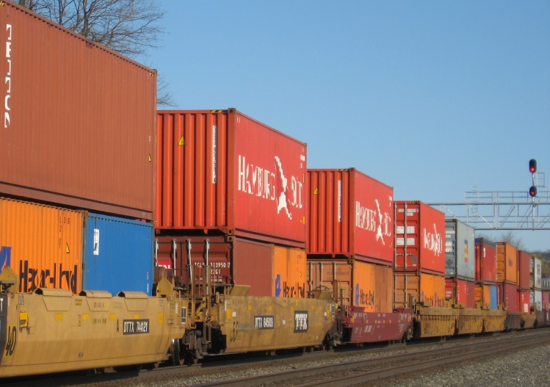
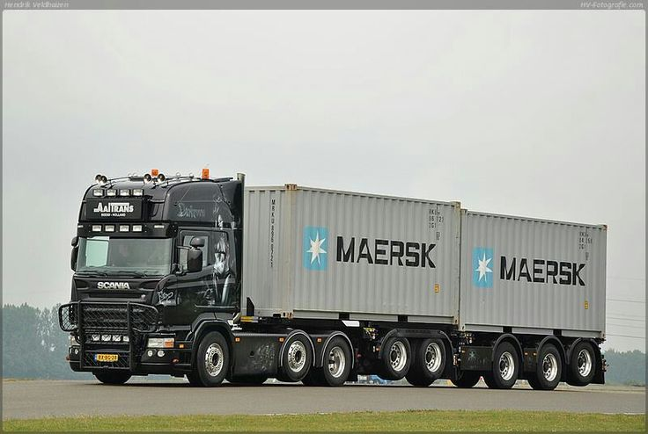
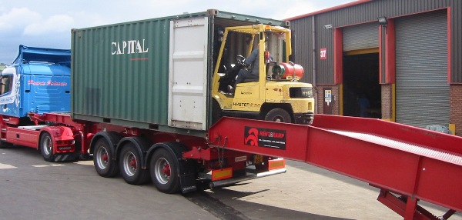
Multimodal (Intermodal) Shipping Solutions

Slide 9

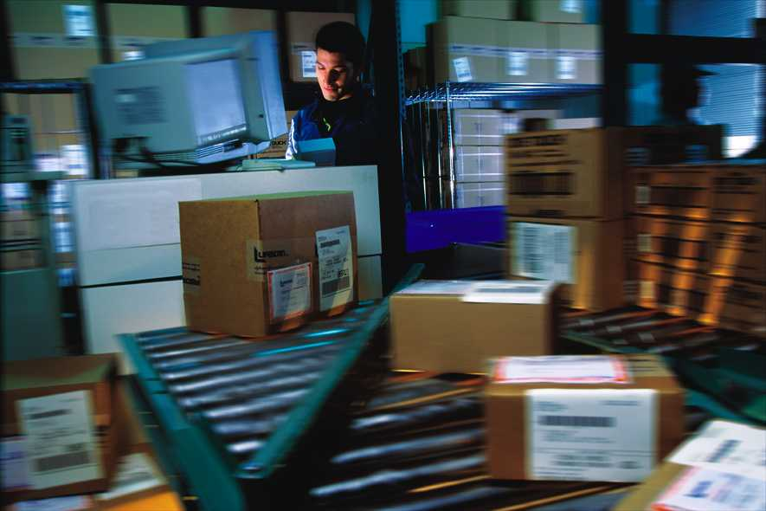
Reverse Logistics
Activities involved in managing, processing, reducing and disposing of hazardous or non-hazardous waste from production, packaging and use of products, including reverse distribution processes.
Also includes product recalls, recycling, and refurbishing

Slide 10
Flow of Goods in Forward & Reverse Logistics
Supplier
Manufacturer
Retailer
Customer
Forward Logistics
Landfill
Waste
Processor
Collector
Reverse Logistics

Slide 11
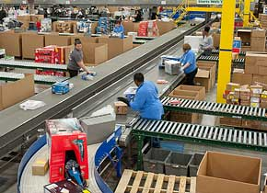

Retail Returns Management Reverse Logistics Challenge

Slide 12
Hierarchy of Waste Treatment Activities
Reuse
Remanufacturing
Recycling
Disposal with Energy Recovered
Disposal in Landfill
Dyckhoff, H., R. Lackes, and J. Reese, Supply Chain Management and Reverse Logistics, Springer, 2004, p. 165.

Slide 13
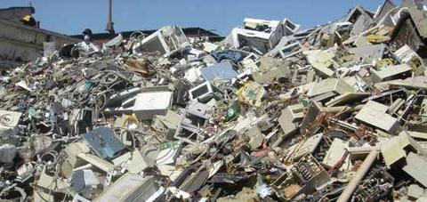
Reverse Logistics: E-Waste Problem!!
A Mountain of Waste

Slide 14
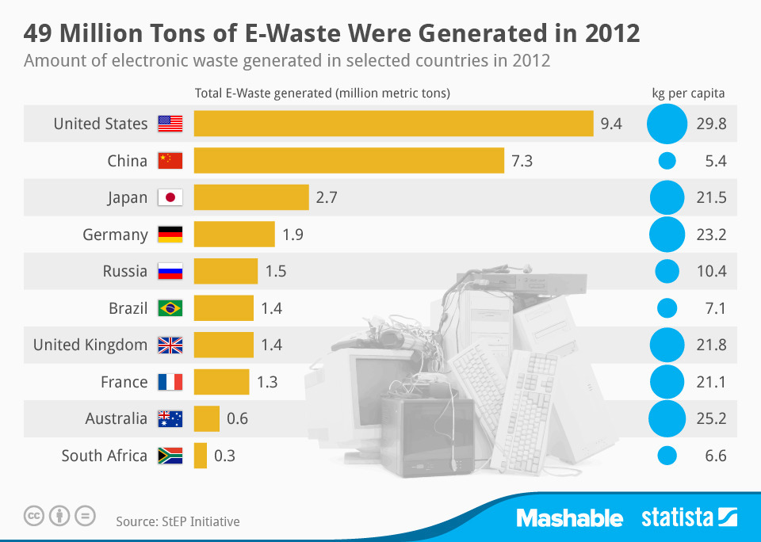
E-Waste Global Volumes 1 Metric Ton = 1.102 U.S. Ton 1 kg = 2.2 pounds
http://www.wastedive.com/news/us-produces-most-per-capita-e-waste-worldwide/266465/

Slide 15
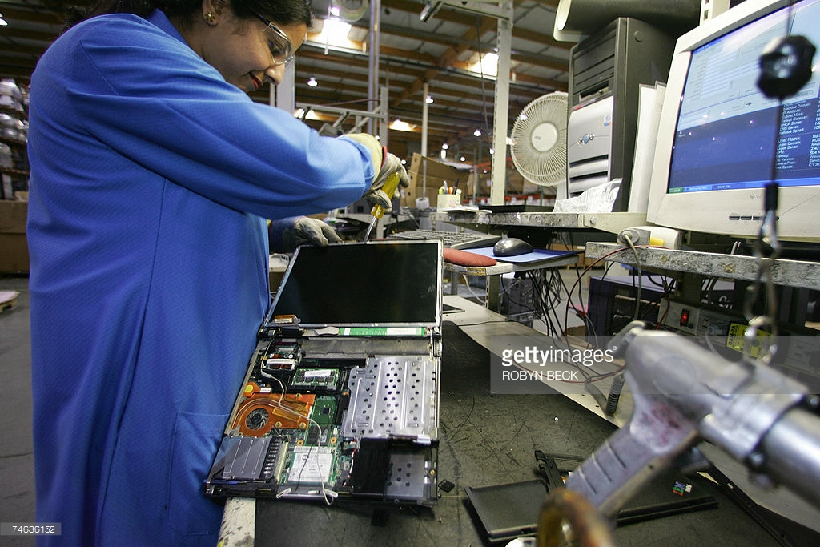
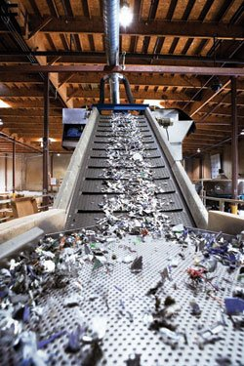
e-Waste Recycling Plant Roseville, CA Built by, and formerly(?) operated by, Hewlett Packard (HP)

Slide 16
Inventory Turnover (or turn rate)
Average Aggregate Inventory Value: Total value (at cost) of all items on hand in inventory at any one time, including raw materials, work-in-process, and finished goods.
Annual Sales (at Cost): This is only for finished goods, valued at cost, not final sale price. Also known as Cost of Goods Sold (COGS).

Slide 17
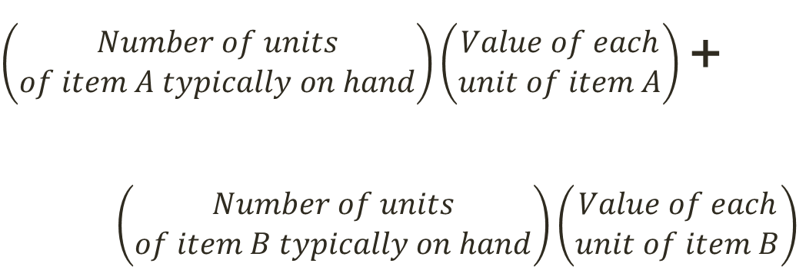
Average Aggregate Inventory Value
Example for inventory consisting of only items A and B:
$\left(\begin{aligned}Number of units \\ of item A typically on hand\end{aligned}\right)\left(\begin{aligned}Value of each \\ unit of item A\end{aligned}\right)$ +
$\left(\begin{aligned}Number of units \\ of item B typically on hand\end{aligned}\right)\left(\begin{aligned}Value of each \\ unit of item B\end{aligned}\right)$
Manufacturing firms: Typically about 25% of their total assets tied up in inventory.
Wholesale and retail firms: Typically about 75%.

Slide 18
Weeks of Supply
In some low-inventory operations, days or even hours are a better unit of time for measuring inventory

Slide 19
Example – Calculating Weeks of Supply and Inventory Turnover
A recent accounting statement showed total inventories (raw materials + WIP + finished goods) to be $6,821,000. This year’s “cost of goods sold” is $19.2 million. The company operates 52 weeks per year. How many weeks of supply are being held? What is the inventory turnover?

Slide 20
Example - Continued
The “best” inventory level, even when expressed as turnover, cannot be determined easily.
Good starting point is to benchmark leading firms in the industry.

Slide 21
Example: Calculating Inventory Measures
At Acme Pharma Corp, the cost of goods sold last year was $10,000,000. The breakdown of raw materials, WIP, and finished goods inventories are shown on the next slide. The best inventory turnover in the company’s industry is six turns per year. If the company has 52 business weeks per year, how many weeks of supply were held in inventory? What was the inventory turnover? What should the company do to improve its inventory situation?

Slide 22
Acme Pharma Corp Data
 | Item No. | Average Level | Unit Value
Raw Materials | 1 | 14000 | $ 5.00
 | 2 | 10000 | $ 3.20
 | 3 | 4000 | $ 6.00
 | 4 | 24000 | $ 1.00
 | 5 | 8000 | $ 1.50
Work in process | 6 | 3200 | $ 70.00
 | 7 | 1600 | $ 90.00
 | 8 | 2800 | $ 75.00
 | 9 | 2400 | $ 80.00
 | 10 | 4000 | $ 100.00
Finished goods | 11 | 600 | $ 200.00
 | 12 | 400 | $ 350.00
 | 13 | 500 | $ 280.00
 | 14 | 200 | $ 500.00
 | 15 | 400 | $ 420.00

Slide 23
Selecting a Supplier using Total Cost Approach
Consider these costs for each supplier:
Material costs
Freight costs
Inventory costs
Administrative costs

Slide 24
Material Costs
Negotiating with suppliers for provision of service or product results in price per unit (or application of service)
Material costs equal annual requirements (D) multiplied by price per unit, p.
Annual material costs = pD

Slide 25
Freight Costs
Varies depending on supplier location, size of shipments, number of shipments per year, mode of transportation
Full truckload shipments (TL) are lower cost per pound than less-than-truckload shipments (LTL)
Air transportation is more expensive than truck or rail transportation

Slide 26
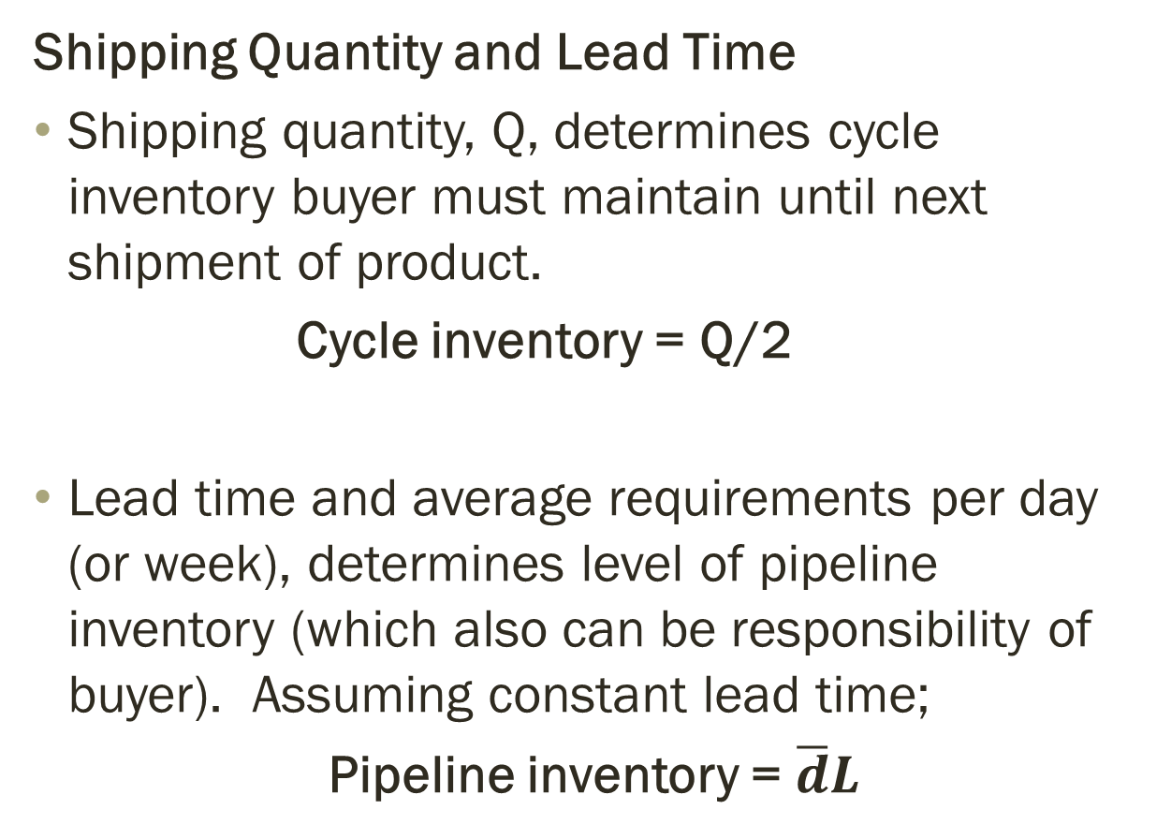
Inventory Costs
Shipping Quantity and Lead Time
Shipping quantity, Q, determines cycle inventory buyer must maintain until next shipment of product.
Cycle inventory = Q/2
Lead time and average requirements per day (or week), determines level of pipeline inventory (which also can be responsibility of buyer). Assuming constant lead time;
Pipeline inventory = $\overline{d}L$

Slide 27
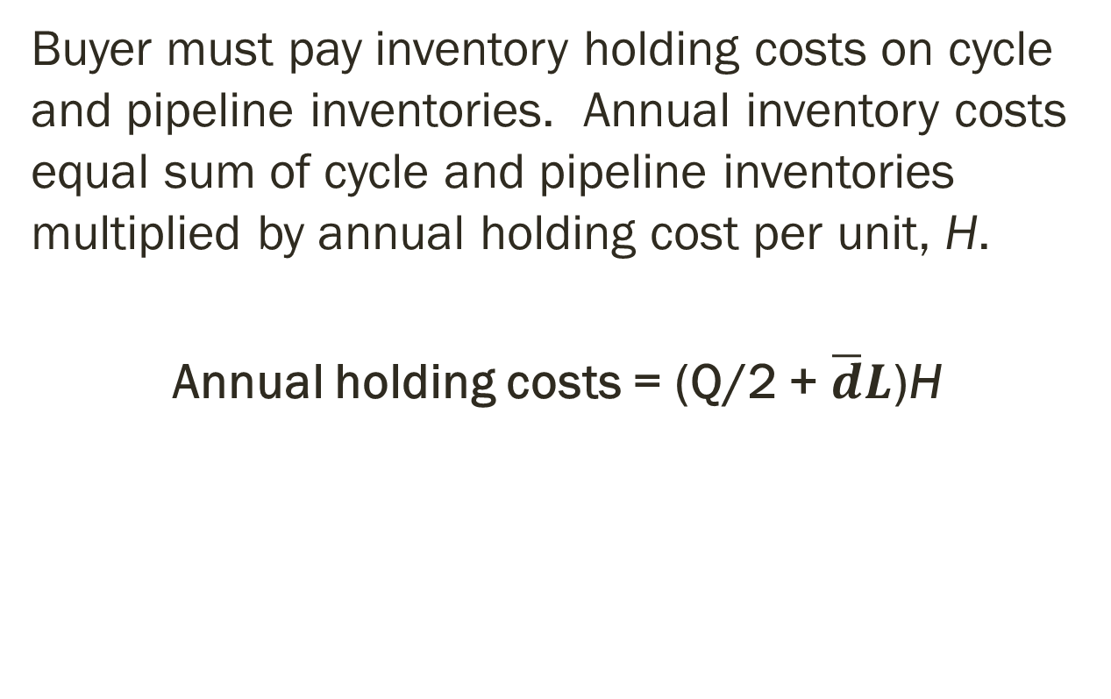
Inventory Costs (continued)
Buyer must pay inventory holding costs on cycle and pipeline inventories. Annual inventory costs equal sum of cycle and pipeline inventories multiplied by annual holding cost per unit, H.
Annual holding costs = (Q/2 + $\overline{d}L$)H

Slide 28
Administrative Costs
Supply contacts must be monitored and frequent interactions with supplier may be required.
Administrative costs
Managerial time
Travel
Other variable costs associated with supplier interaction

Slide 29

Total Annual Cost Use to Compare Supplier
Total annual cost =
pD + Freight Costs + (Q/2 + $\overline{d}L$)H + Administrative Costs

Slide 30
Example of Total Cost Analysis for Supplier Selection
Excell Pharma manufactures several types of drugs for the control of diabetes. The company is looking at new sources for a key raw material (semi-processed) used to make its most popular treatment drug. Excell has identified three potential suppliers for this raw material, and each is located in a different part of the world. Important cost considerations are the price per pound, freight costs, inventory costs, and contract administrative costs. The annual requirements for the raw material is 30,000 pounds. Assume Excell has 250 business days per year. The company uses an annual holding cost equal to 20% of the items value.
Managers have acquired data for each supplier.
Which supplier provides the lowest total annual cost to Excell?

Slide 31
Example of Total Cost Analysis for Supplier Selection
 | Annual Freight Costs
Supplier | Shipping Quantity (pounds/shipment)
 | 1,000 | 2,000 | 3,000
Belfast | $38,000 | $26,000 | $23,700
Hong Kong | $91,500 | $74,700 | $67,000
Shreveport | $28,500 | $24,000 | $20,000

Slide 32
Example - Continued
 | Costs and Shipping Lead Times
Supplier | Price/lb | Annual inventory Carrying cost/lb | Shipping lead time (days) | Administrative
Belfast | $50.00 |  | 16 | $280,000
Hong Kong | $46.50 |  | 40 | $750,000
Shreveport | $49.50 |  | 3 | $150,000

Slide 33

Example - Solutions
Average requirements per day = $\overline{d}$ = 30,000/250 = 120
Total annual cost = pD + Freight costs + (Q/2 + $\overline{d}L$)H + Administrative costs
For Belfast:

Slide 34
Additional Performance Dimensions for Suppliers
Quality of supplier’s materials – consider hidden costs of poor quality!
Factors influencing customer service with less inventory (e.g., shorter lead times and on-time delivery).
Environmental impact: Green purchasing – identifying, assessing, and managing flow of environmental waste and finding ways to reduce it and minimize its impact on environment.

Slide 35
Preference Matrix for Excell
Excell has finished conducting a total cost analysis for its three international suppliers (our prior exercise). The company also considers on-time delivery, consistent quality, and environmental stewardship in its selection process. Management gives each criterion a weight (total of 100 points), and each supplier is given a score (1 = poor, 10 = excellent) on each criterion.
 | Score
Criterion | Weight | Belfast | Hong Kong | Shreveport
Total cost | 25 | 8 | 6 | 9
On-time delivery | 30 | 9 | 6 | 7
Consistent Quality | 30 | 8 | 9 | 6
Environment | 15 | 9 | 6 | 8
Notes:
Which is now the best supplier to select?

